Slide 1
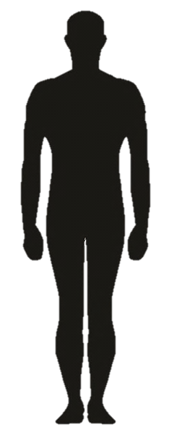
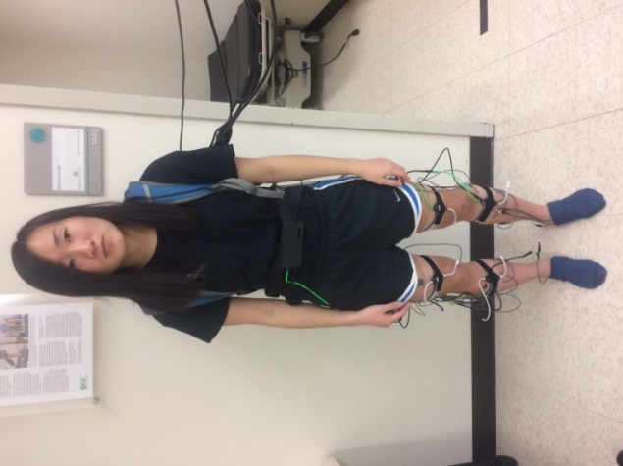
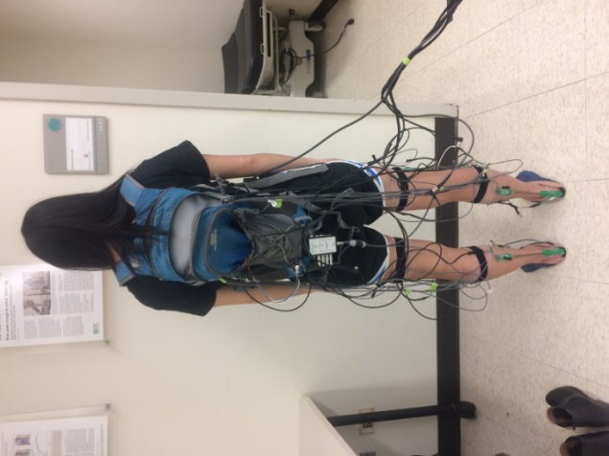
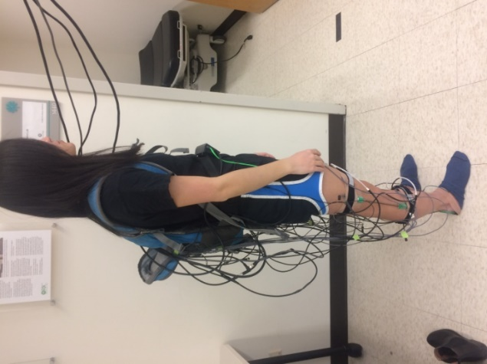
IMU: Waist
R
L
EMG: VL, RF, BF, ST
GONIO: Knee
IMU: Thigh
X
Z
Y
EMG: TA, MG, SOL
GONIO: Ankle
IMU: Shank

Slide 2
EMG(I/C): 7(70)
EMG(B): 14(140)
ALL(I/C): 11(166)
ALL(B): 22(332)
Unilateral
Bilateral
GONIO(I/C): 2(24)
GONIO(B): 4(48)
IMU(I/C): 2(72)
IMU(B): 4(144)

Slide 3
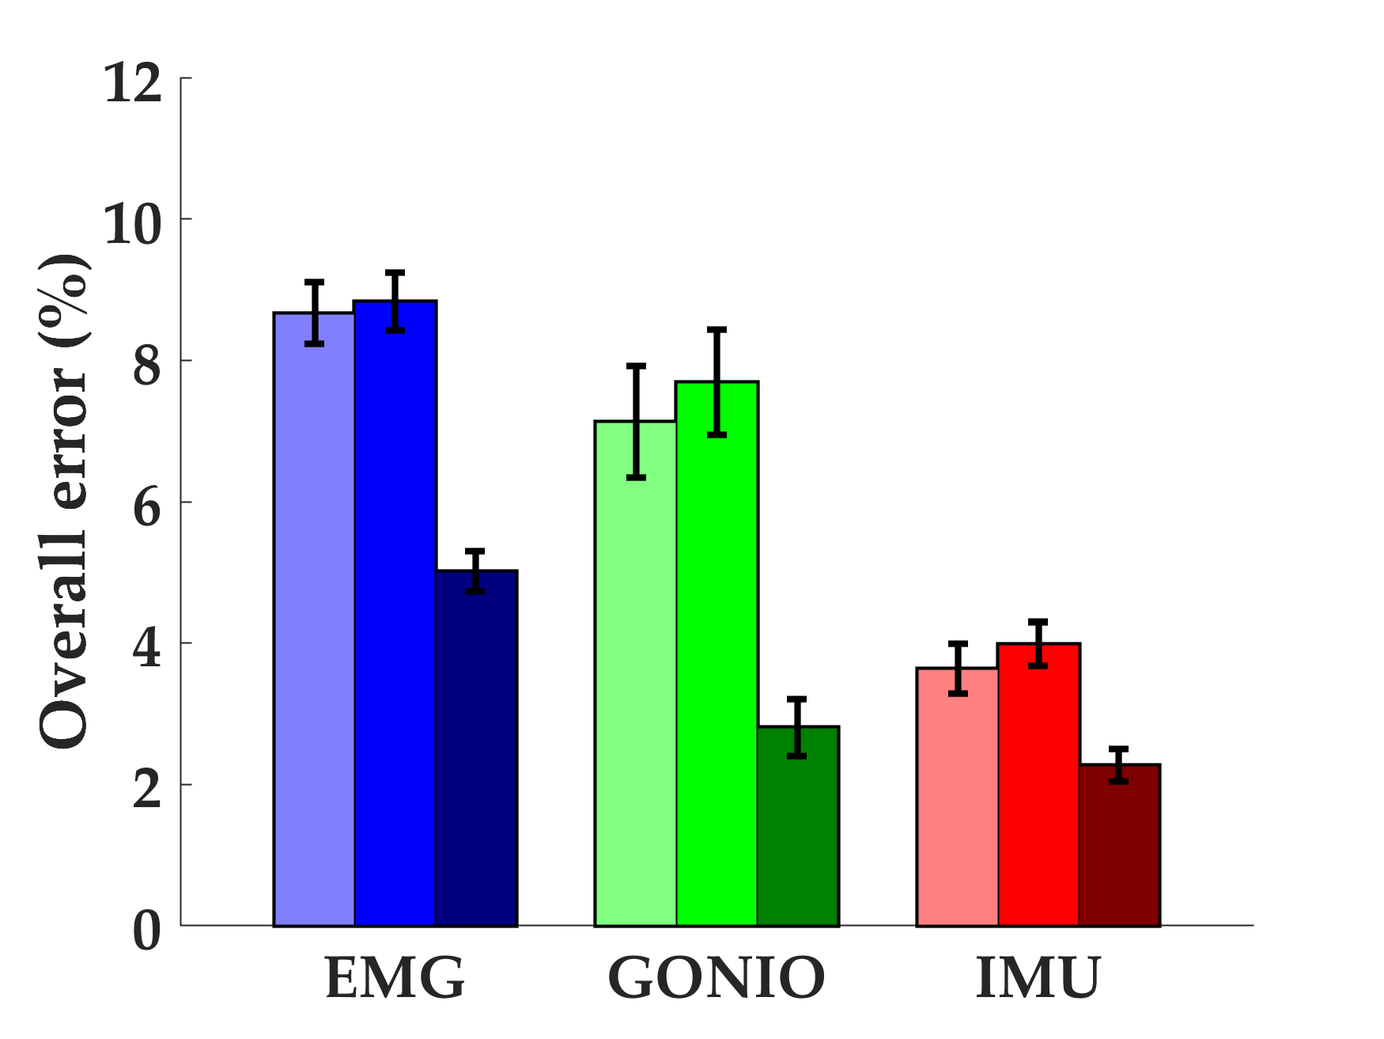
*
*
*
Contra.
Ipsi.
Bilat.

Slide 4
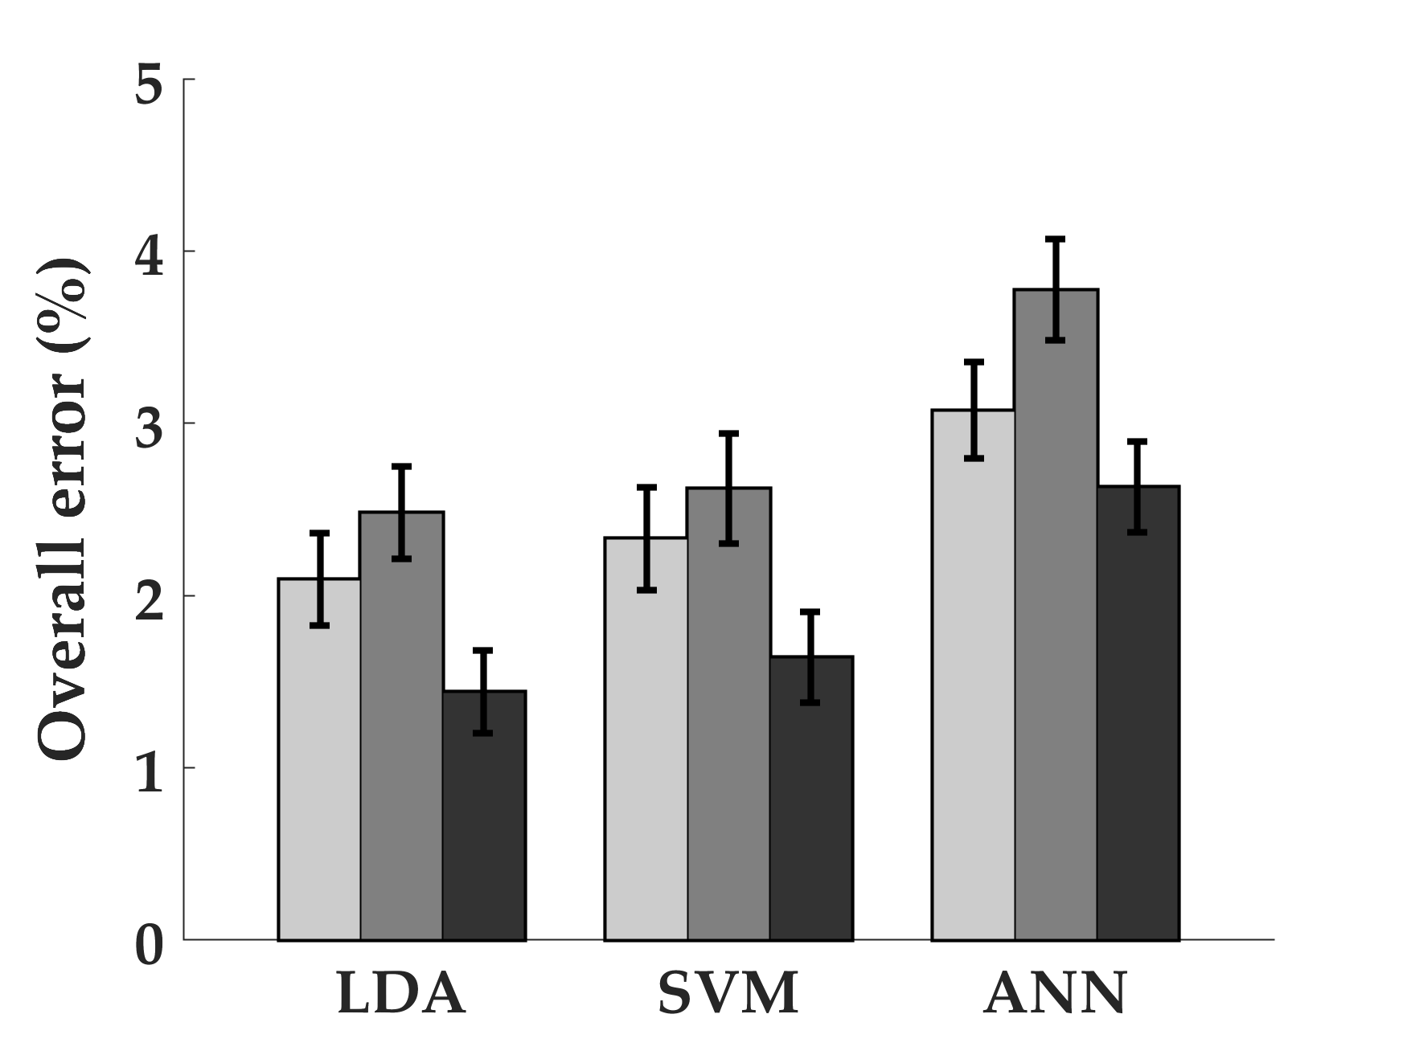
*
*
*
Contra.
Ipsi.
Bilat.

Slide 5
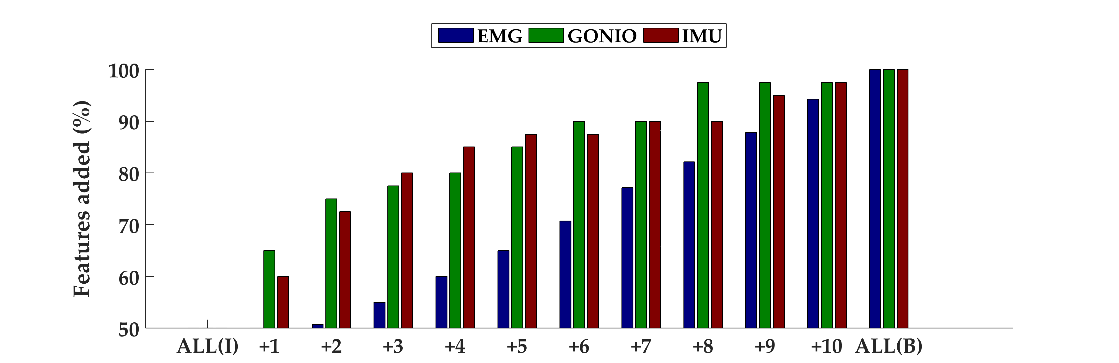
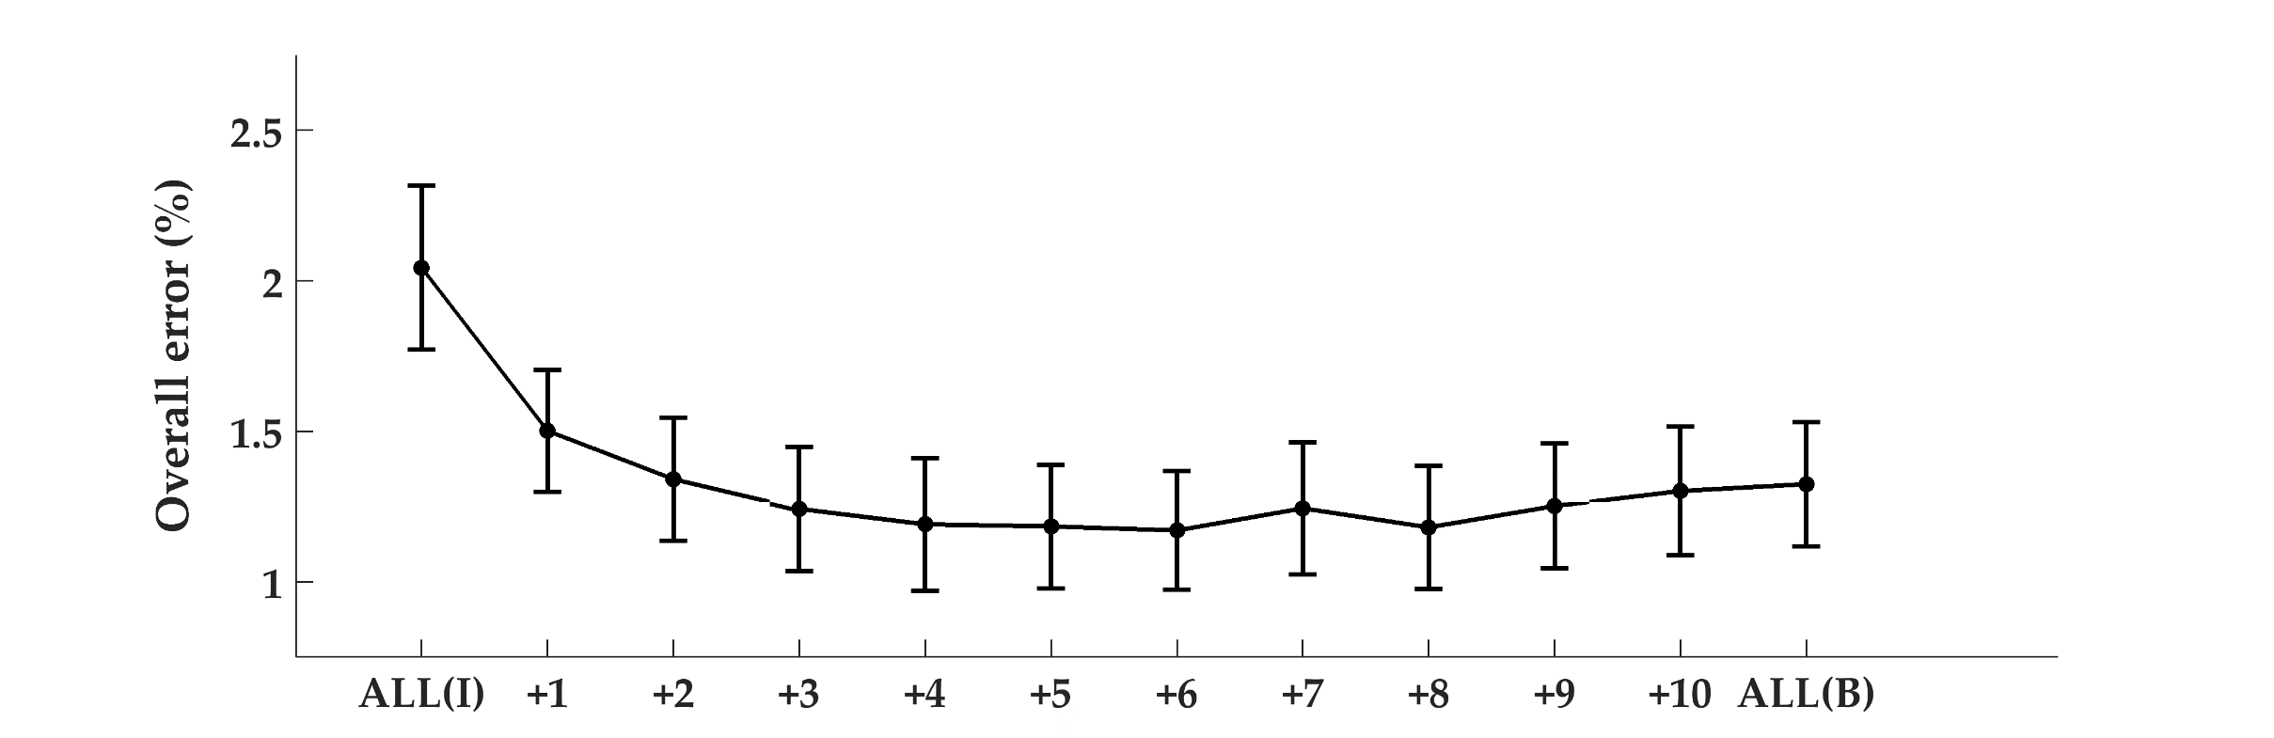
*
Overall: 1.50 [0.20]
Steady-state: 0.87 [0.13]
Transitional: 4.35 [0.66]
Overall: 1.19 [0.22]
Steady-state: 0.67 [0.13]
Transitional: 3.49 [0.65]

Slide 6
 |  | Steady-state (%) | Transitional (%) | Overall (%)
1. | Prosthesis only | 0.53 | 3.75 | 0.90
2. | Prosthesis, Contra Shank | 0.36 | 3.00 | 0.67
3. | Prosthesis, Contra Shank † | 1.26 | 4.99 | 1.69
4. | Prosthesis, Contra Thigh | 0.30 | 2.50 | 0.55
5. | Prosthesis, Contra Thigh † | 1.42 | 3.99 | 1.72
6. | Prosthesis, Contra Thigh/Shank | 0.20 | 1.50 | 0.35
7. | Prosthesis, Contra Thigh/Shank † | 1.02 | 3.49 | 1.31
8. | Prosthesis, Contra Thigh/Shank ▼ | 0.53 | 3.74 | 0.90
 | Total decisions | 3027 | 400 | 3427
† Control system neither merges LW and RA classes nor includes 90 ms delay
▼Control system neither merges LW and RA classes nor includes 90 ms delay; toe off classifier uses prosthesis signals only

Slide 7
Incoming
activity
Mode and phase
-specific classifiers
Predicted
activities
HC_{LW}
TO_{LW}
(SS) LW
(T) RA, RD, SA, SD
LW
HC_{RA}
TO_{RA}
(SS) RA
(T) LW
RA
Leg-specific (R or L)
HC_{RD}
TO_{RD}
(SS) RD
(T) LW
RD
HC_{SA}
TO_{SA}
(SS) SA
(T) LW
SA
HC_{SD}
TO_{SD}
(SS) SD
(T) LW
SD

Slide 8
Classifier | LW | RA | RD | SA | SD | Total
HC_{LW} | 4523 | 240 | 240 | 239 | 248 | 5490
TO_{LW} | 4637 | 245 | 246 | 253 | 243 | 5624
HC_{RA} | 243 | 1408 |  |  |  | 1651
TO_{RA} | 252 | 1416 |  |  |  | 1668
HC_{RD} | 239 |  | 1757 |  |  | 1996
TO_{RD} | 245 |  | 1762 |  |  | 2007
HC_{SA} | 238 |  |  | 489 |  | 727
TO_{SA} | 245 |  |  | 472 |  | 717
HC_{SD} | 248 |  |  |  | 475 | 723
TO_{SD} | 242 |  |  |  | 478 | 720

Slide 9
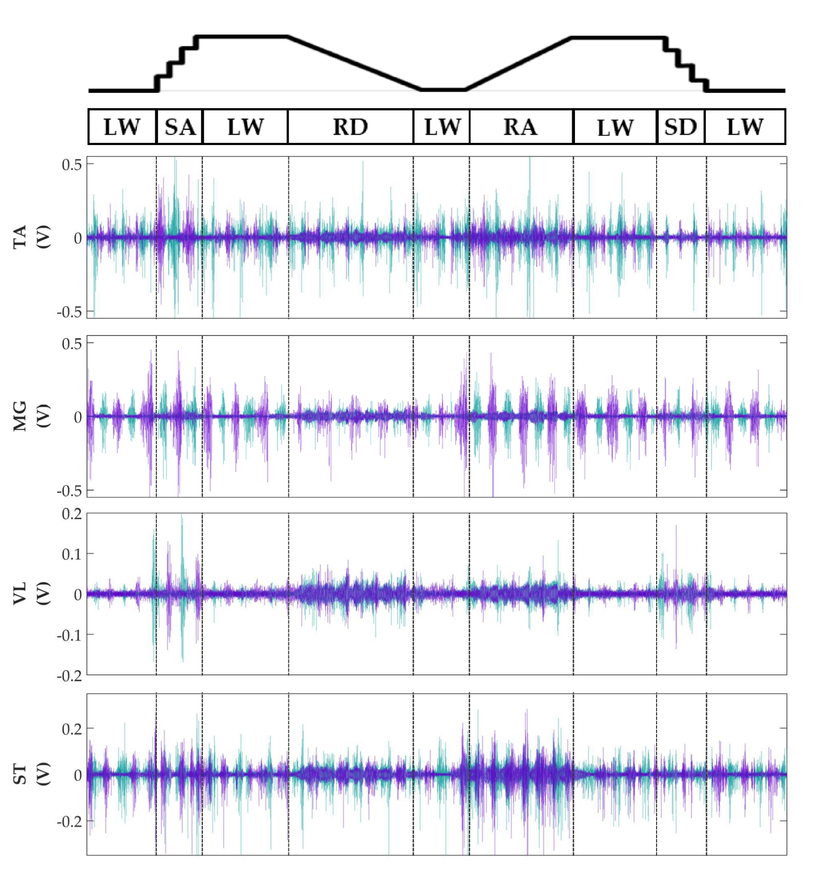

Slide 10
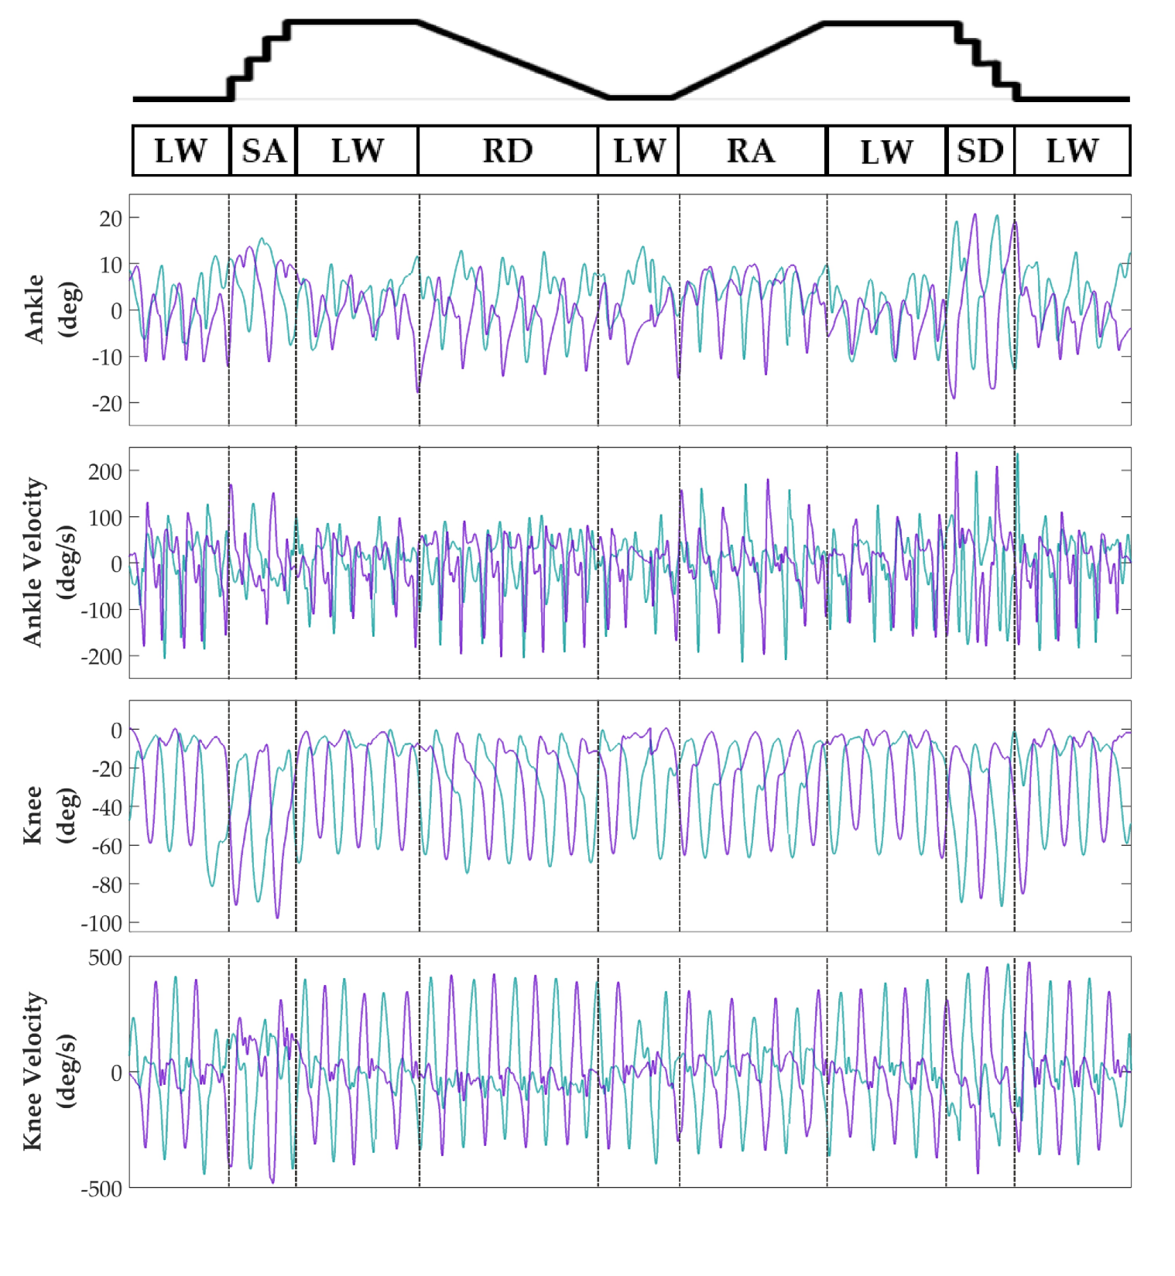

Slide 11
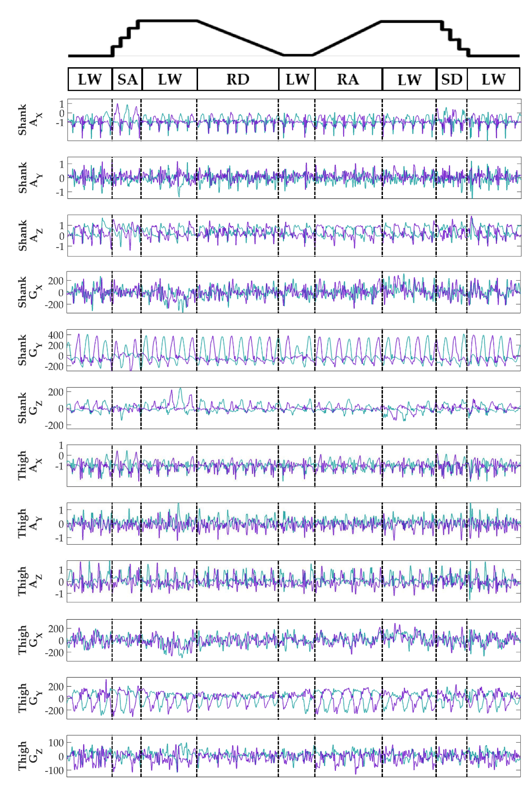

Slide 12
